Slide 1
WELCOME TO THE CONTENT MANAGEMENT SYSTEM (CMS) TRAINING
Open a browser (Firefox preferably)
Type in these URLs to download training material
http://www3.govst.edu/adecastro/CMS/
Download the files to your desktop

Slide 2
WELCOME TO THE CONTENT MANAGEMENT SYSTEM (CMS) TRAINING
Please hold all questions until after the training unless you have a lesson issue
Please refrain from discussions during the training
Have patience. You will get this.

Slide 3
GOVERNOR STATE UNIVERSITY Content Management System (CMS) Training

Slide 4
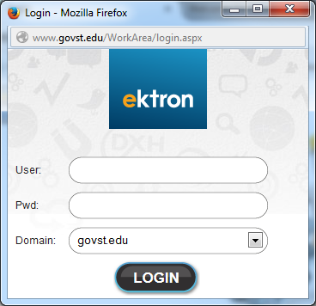
Log in to your GSU Account in the computer
Open up a browser (preferable Firefox)
Type in the URL: http://www.govst.edu/login/cmslogin.aspx
Click on LOGIN
Sign in using your GSU account info

Slide 5
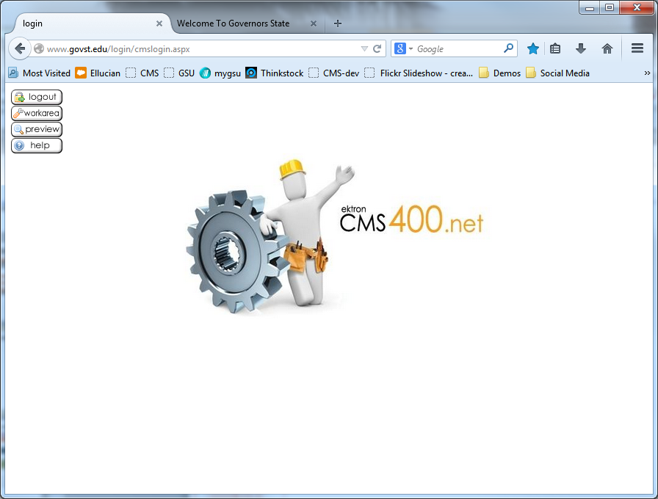
In the CMS window, click on Workarea

Slide 6
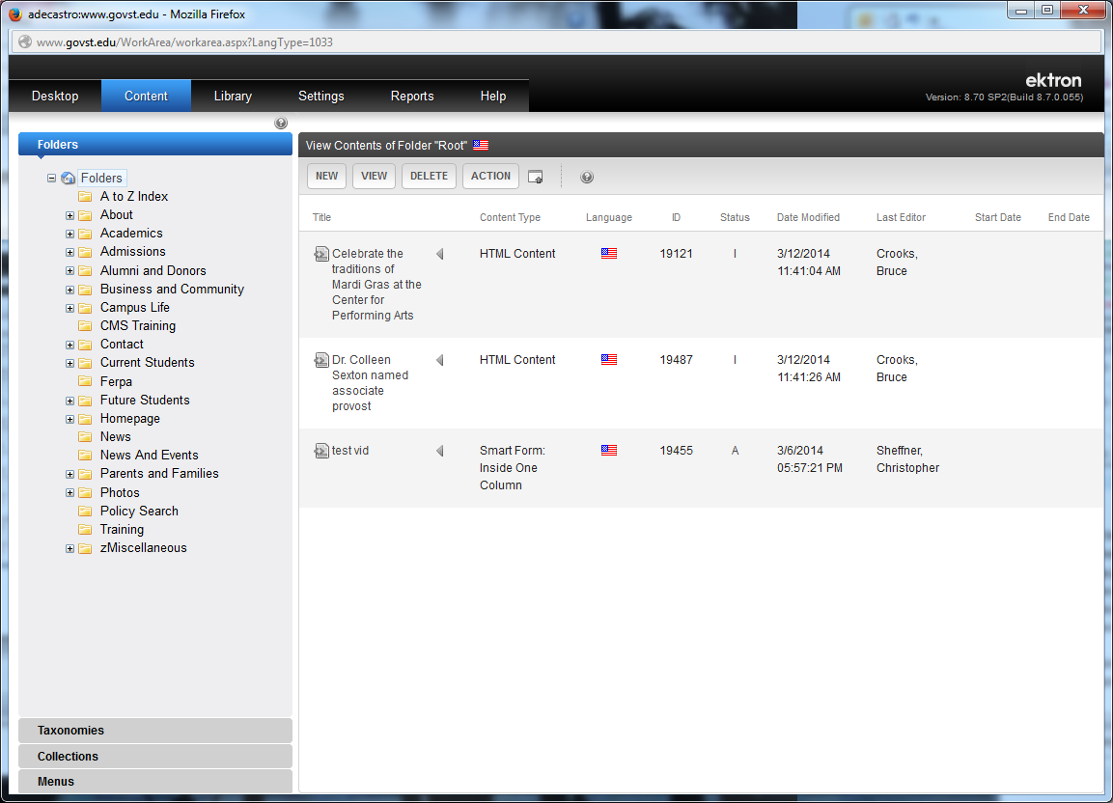
Another window will appear. This is your workarea. Click on Content tab to access the webpages on the GSU Website .

Slide 7
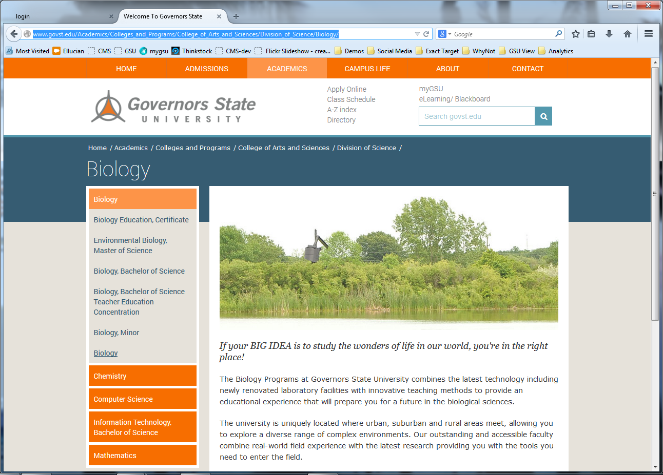
To access your page look at the URL of your webpage:
In this example it’s /Academics/Colleges_and_Programs/College_of_Arts_and_Sciences/Division_of_Science/Biology/

Slide 8
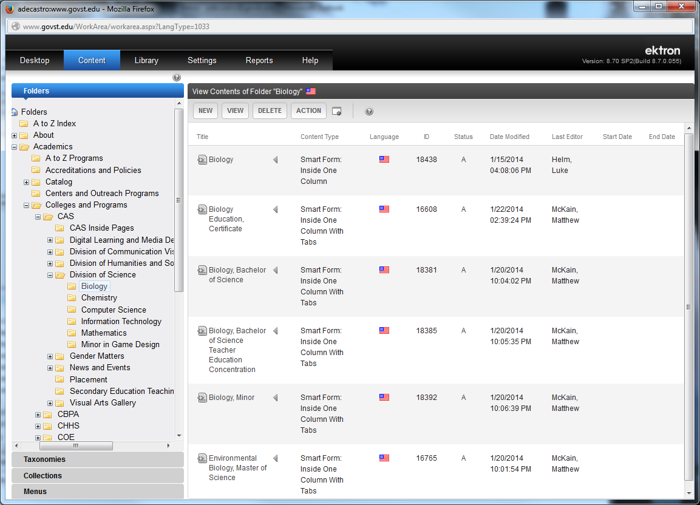
In the work area look for the corresponding directories (folders). In this example it’s: Academics>Colleges_and_Programs>College_of_Arts_and_Sciences (CAS) > Division_of_Science >Biology
Click on the page you want to edit in the right column

Slide 9
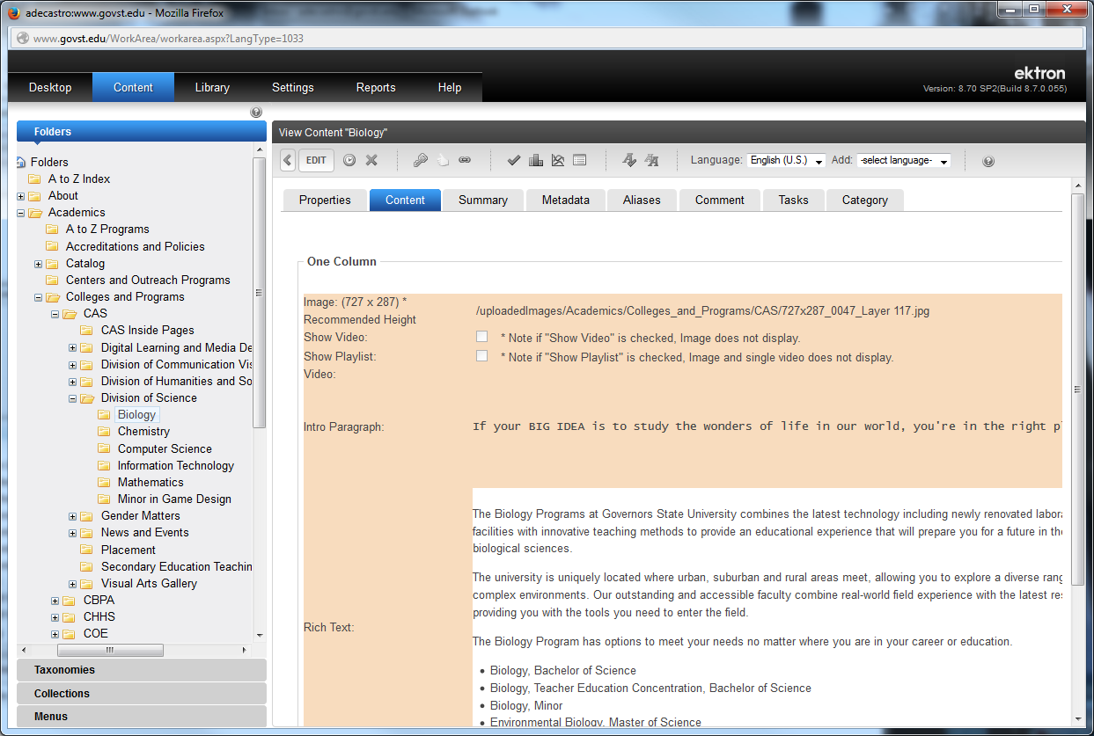
Then once on the page, click on the EDIT Button

Slide 10
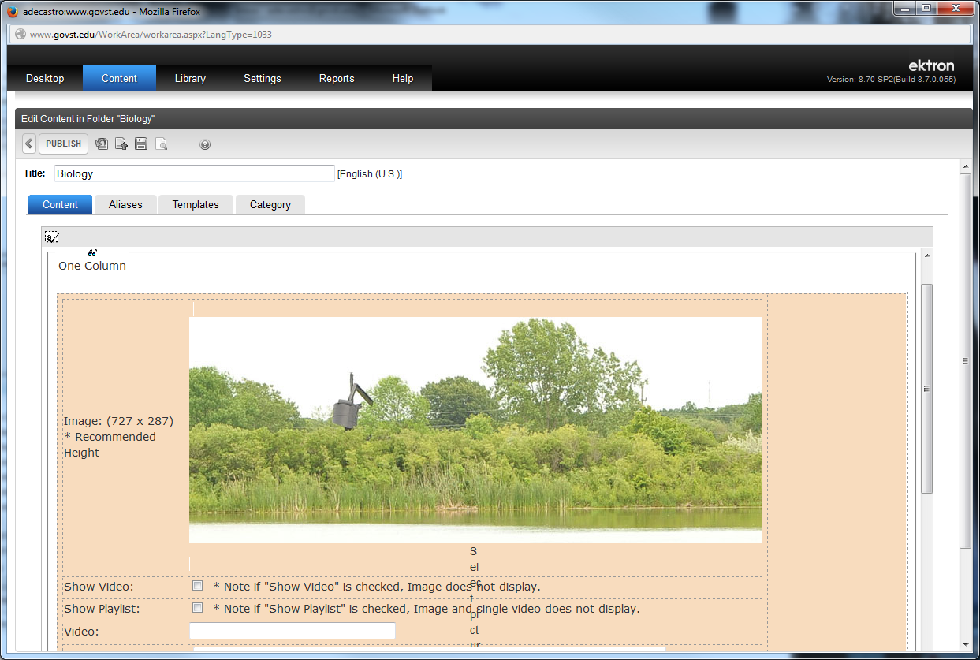
This is the TITLE of your page which corresponds with the blue TITLE bar of your page
This is the Header Image which you can upload an image (It has to be 727 x 287). Click here to upload a new header image for the top of your page. (See slide #14 on Uploading Images)

Slide 11
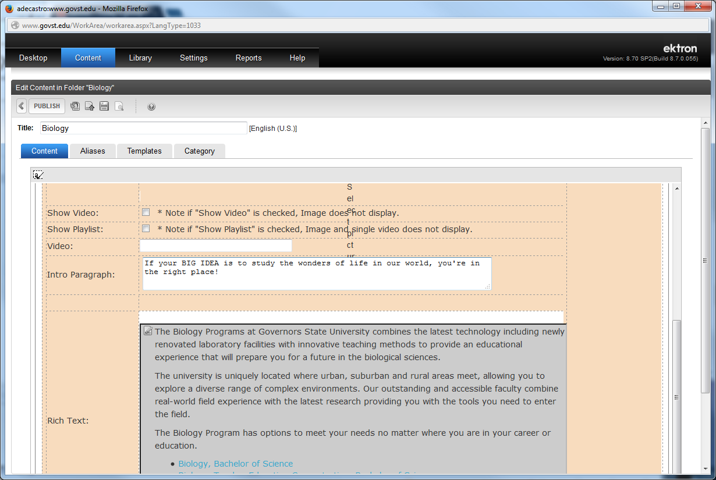
This is if you want to place a YouTube video instead of a Header image
This is the where you place the URL of the YouTube video
This is the where you place an intro paragraph, that’s bigger and more pronounced than content

Slide 12
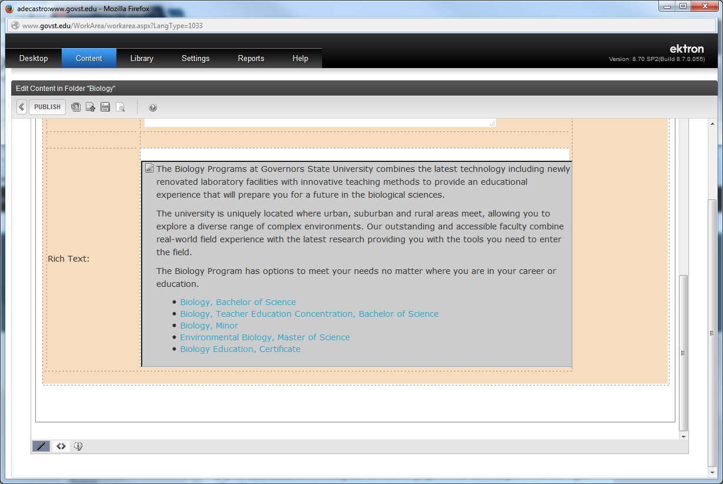
This is your content area
Click here to open an edit window to edit your content

Slide 13
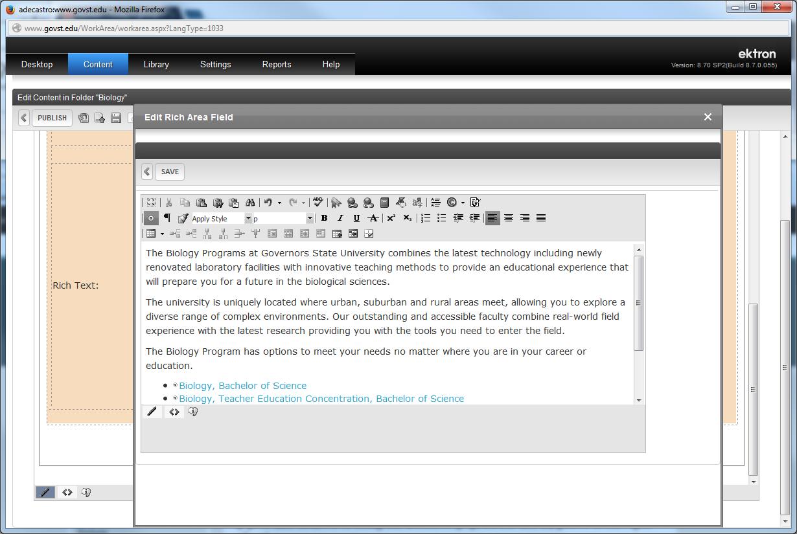
This is your content editing area. This is where you type in or cut and paste your content
These are the tools to format your content, add links to your content, place images into your page, and to create tables in. It resembles most word processing functions like Microsoft Word.

Slide 14
To add content or edit existing content just click in the window where you want to update your content. You can select text and delete them or format them

Slide 15
You can also add images into your content while you’re editing at the same time. Click where you want your image to appear on your content page, then click on the File Cabinet icon to open up the Add File window.

Slide 16
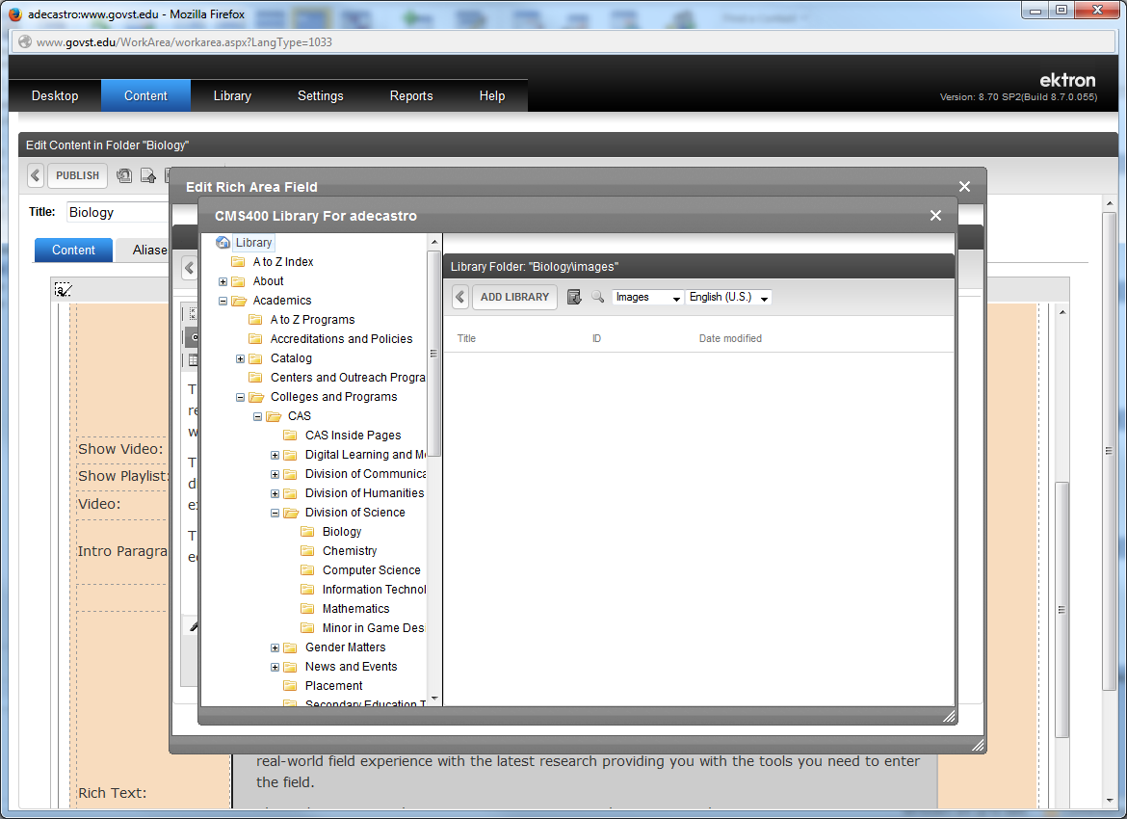
The Add File (which an image is) window appears. The first thing to do is check the folder you need the image to be placed in. It should be placed in the same folder as your webpage is.

Slide 17
To upload your image, click on the Add Library button.

Slide 18
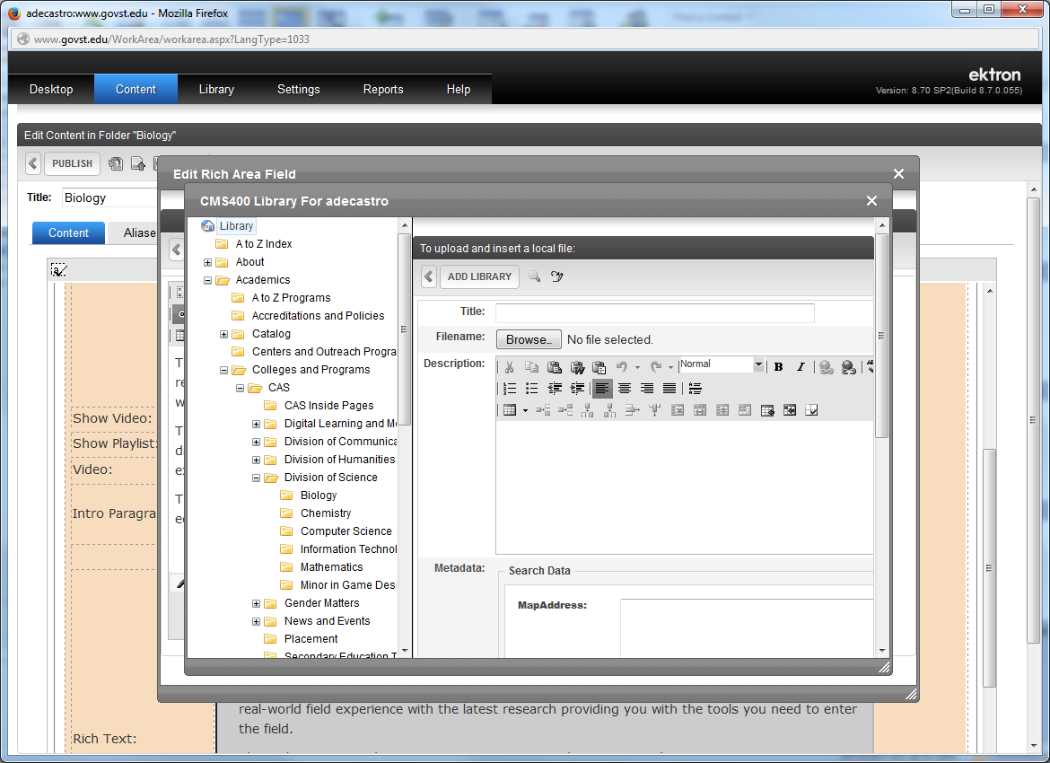
Type in a Title to give it a filename in the CMS .
Then click on the Browse button to select the image you want to upload (the process is like attaching a picture in an email or posting an image in Facebook) .

Slide 19
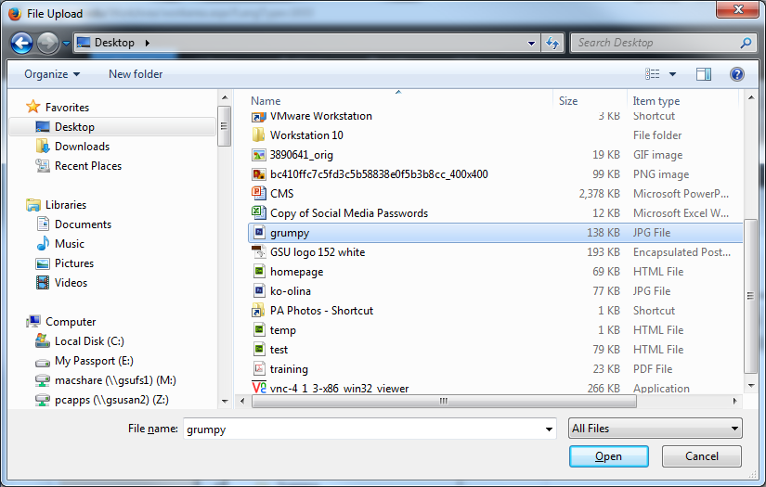
In the upload window that opens, select the image file you want to use in your content then click on the OPEN button

Slide 20
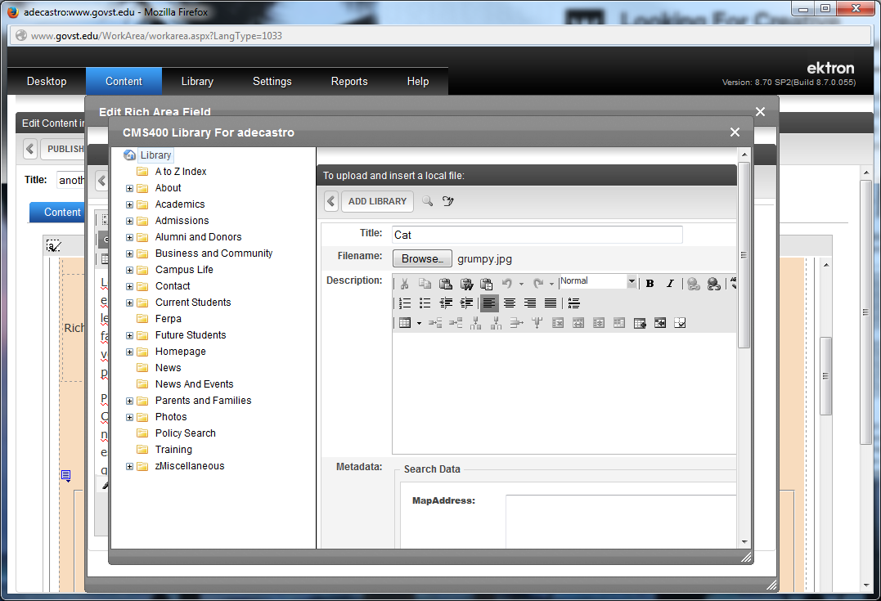
Your image is ready to be uploaded. Click on the ADD LIBRARY button to upload the image and place in your content.

Slide 21
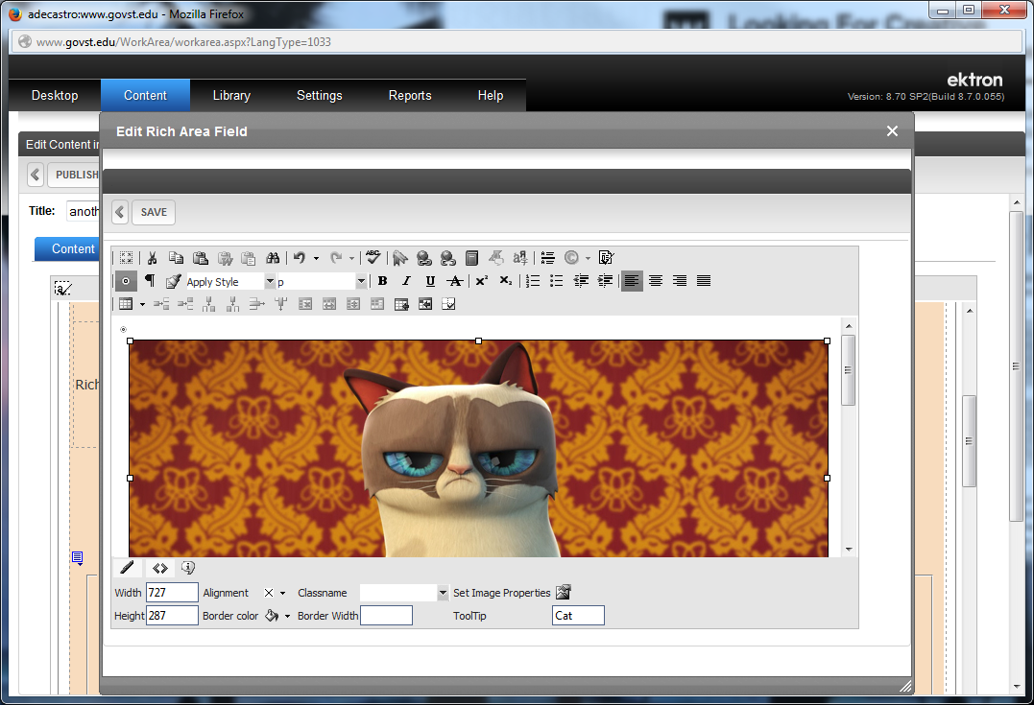
Your image is on your page and uploaded into your directory library. To scale (change size) of your image click on it and look for the white bounding boxes in the corner. Click and drag on one of them to shrink your image.

Slide 22
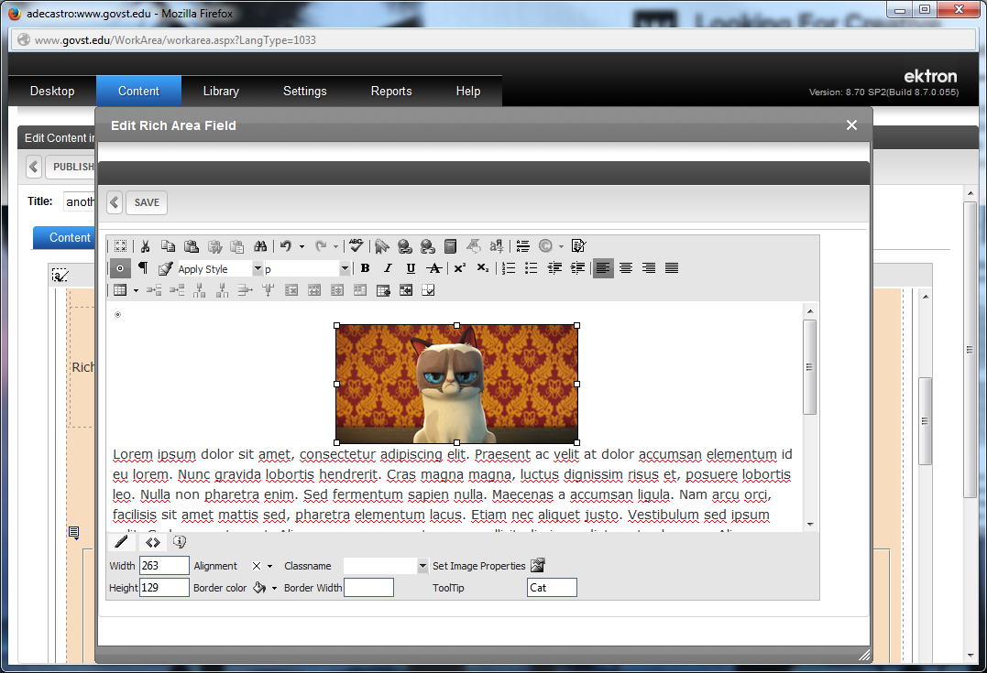
To make your image left aligned or right aligned (with text wrapping around it on either left or right side) click on your image and then click the Set Image Properties icon

Slide 23
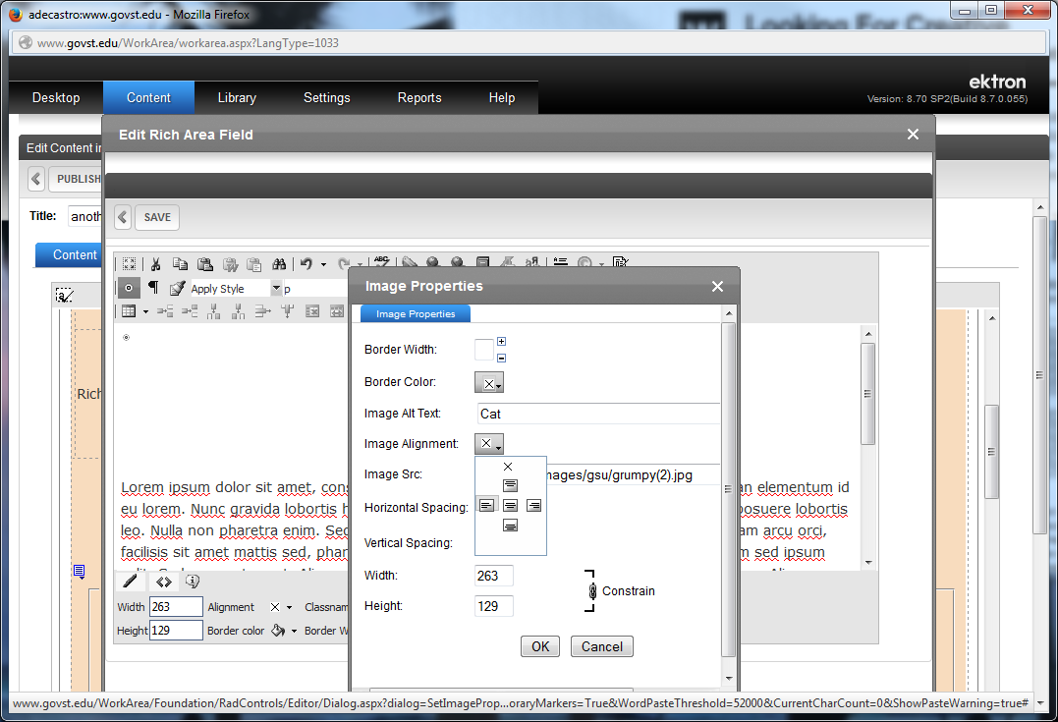
In the Set Image Properties window click on the Image Alignment button and in the drop down select left aligned or right aligned. Then press on the OK button.

Slide 24
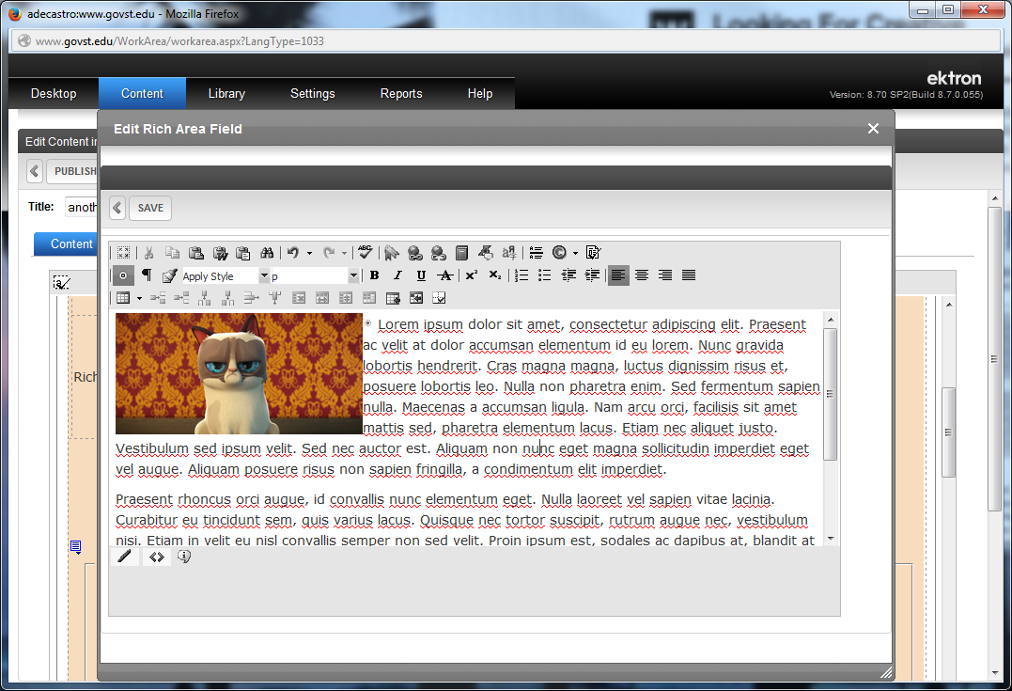
Your image is now left aligned. Click on the Save button if you’re done.

Slide 25
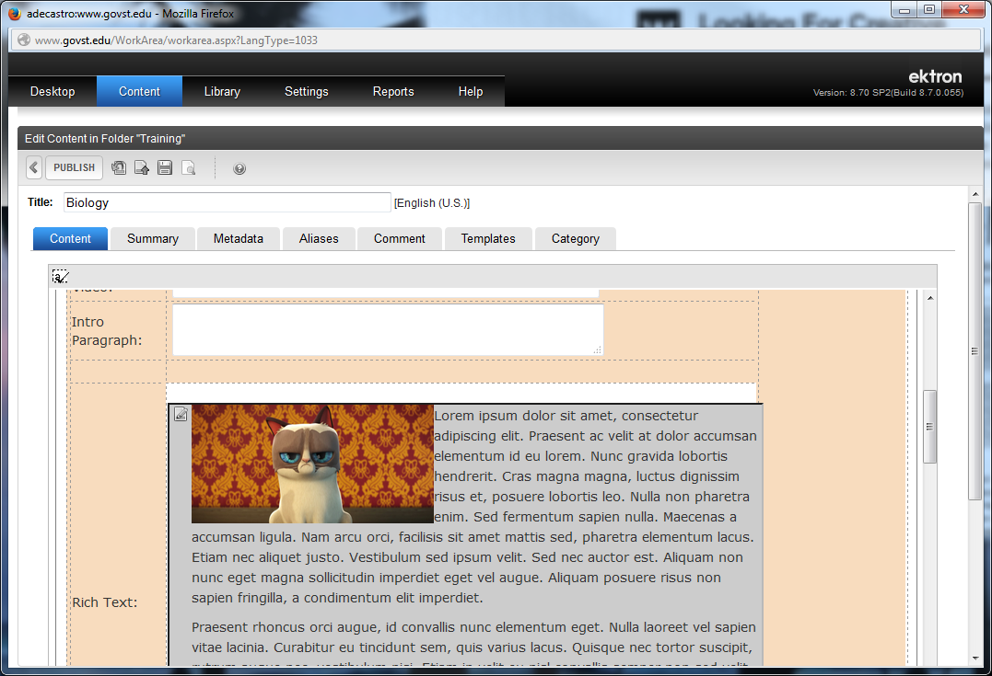
If you’re done editing your content click on the Save File icon to save it (It’s not live yet on the website). Or if you want the updated content to go live on the website you can click on the Publish button.

Slide 26
If you’re done editing your content click on the Save File icon to save it (It’s not live yet on the website. You can also preview your page by clicking on the Preview Page icon before you Publish after you save
If you want the updated content to go live on the website you can click on the Publish button.

Slide 27
If you want to place a link on your webpage, click on the Edit icon to open an edit window to edit your content.

Slide 28
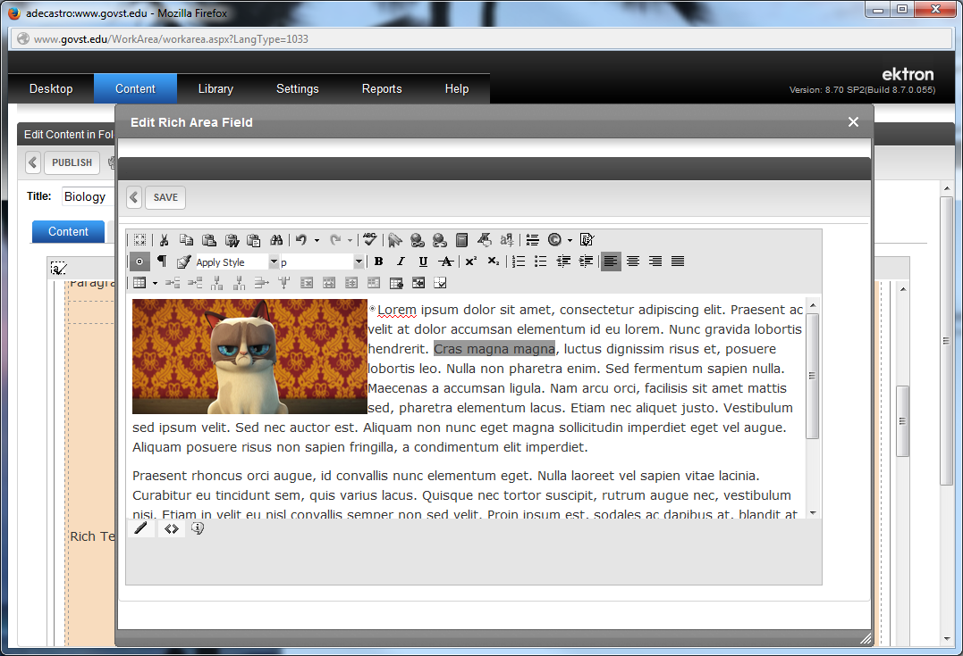
In the Edit Content window, select the text you want to use as a link.

Slide 29
In the Edit Content window, select the text you want to use as a link.
After selecting text, click on the Link tool icon.

Slide 30
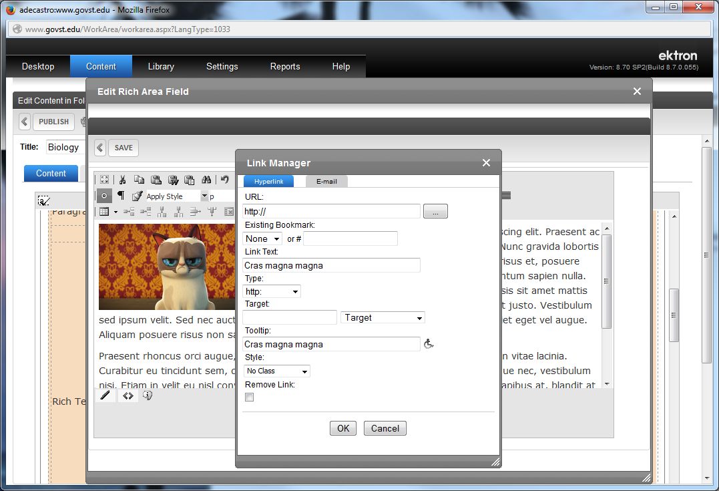
In this form field you can have it link to a site outside of govst.edu (like “yahoo.com”) by typing in the web address here.
If you wanted to link to a page within govst.edu, click on this button

Slide 31
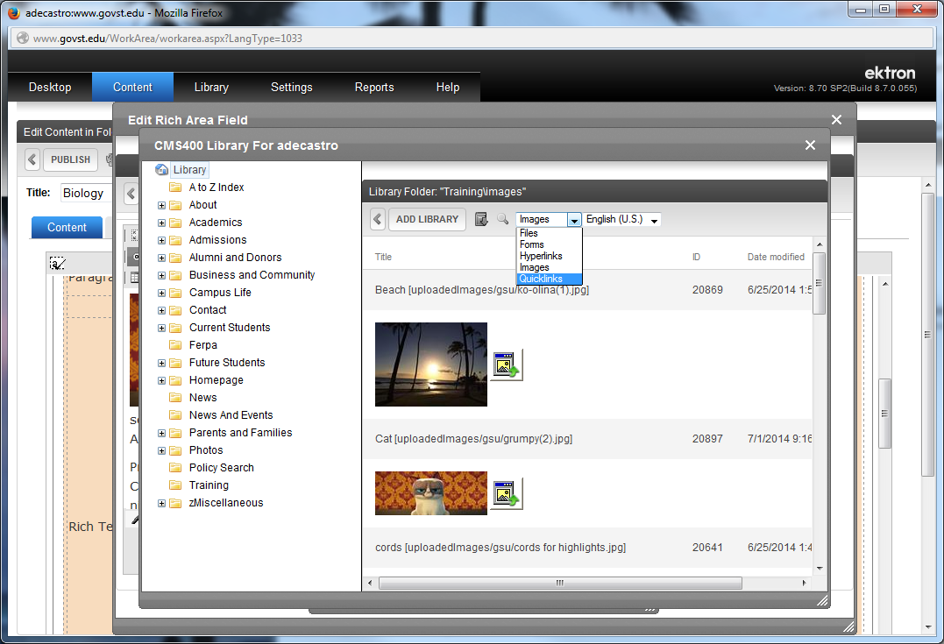
The first thing you want to do is click on this dropdown menu and select Quicklinks from the menu

Slide 32
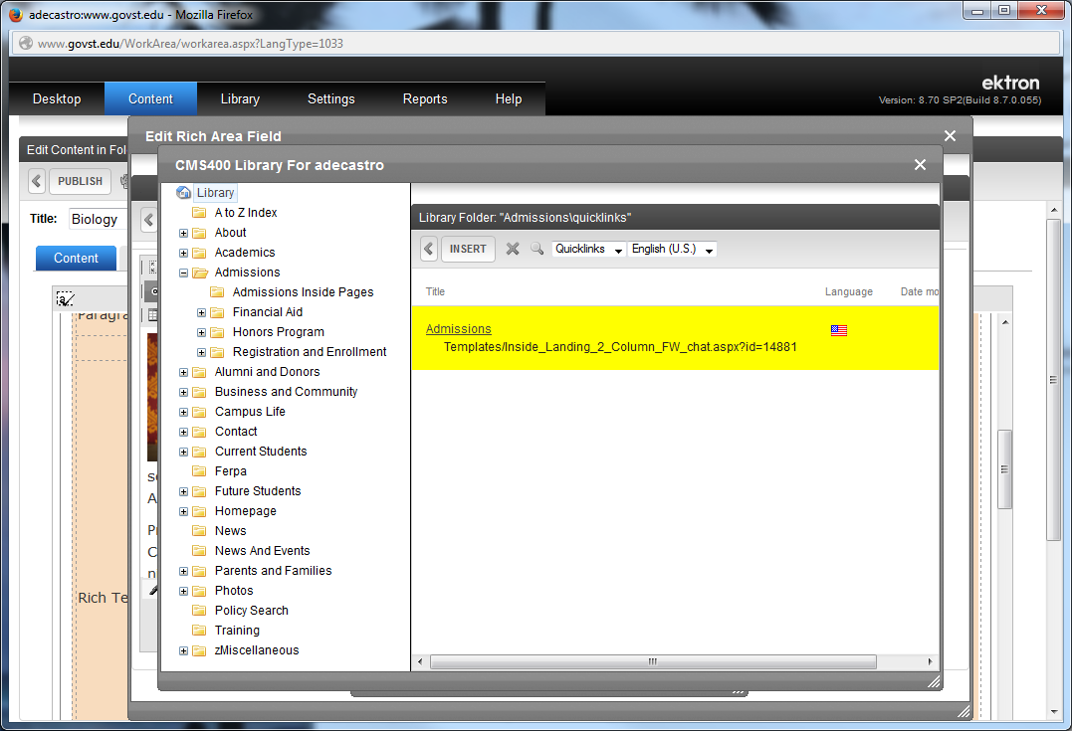
Then select the directory where the webpage you want to link to resides in
Then select page you want to link to
Once the page is highlighted in yellow, click on the Insert button to place the link.

Slide 33
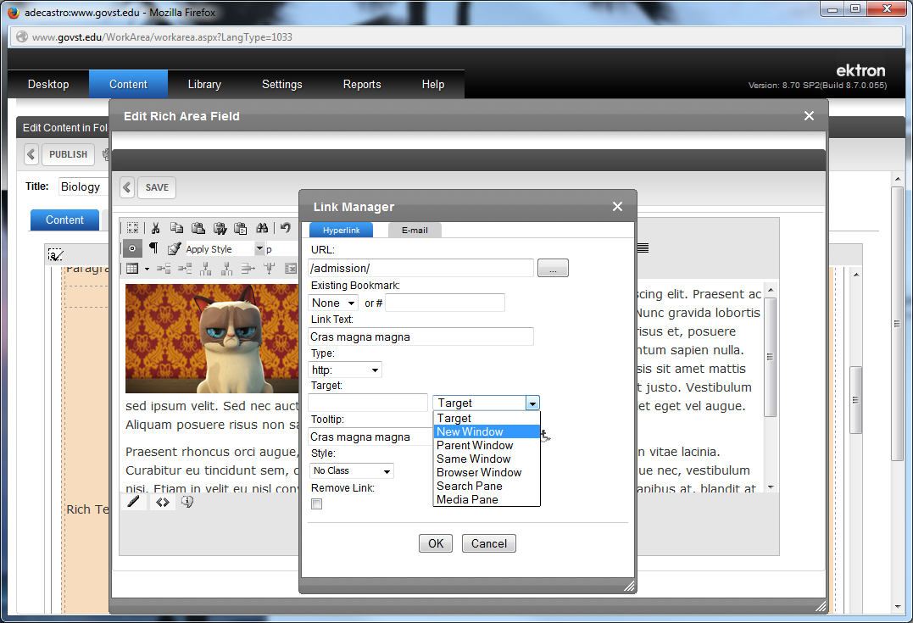
Your link is now selected and ready to be placed.
You also have the option of having the page open up in a brand new tab/browser by selecting New Window in this drop down menu. Meaning: the page will open leaving the original page open as well.
Press OK to save and place the link

Slide 34
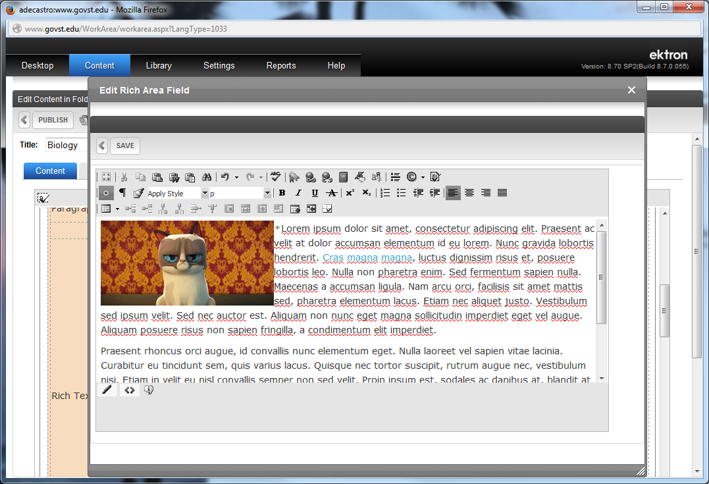
Your link is now embedded unto your web page content.
Click on Save to save the edit.

Slide 35
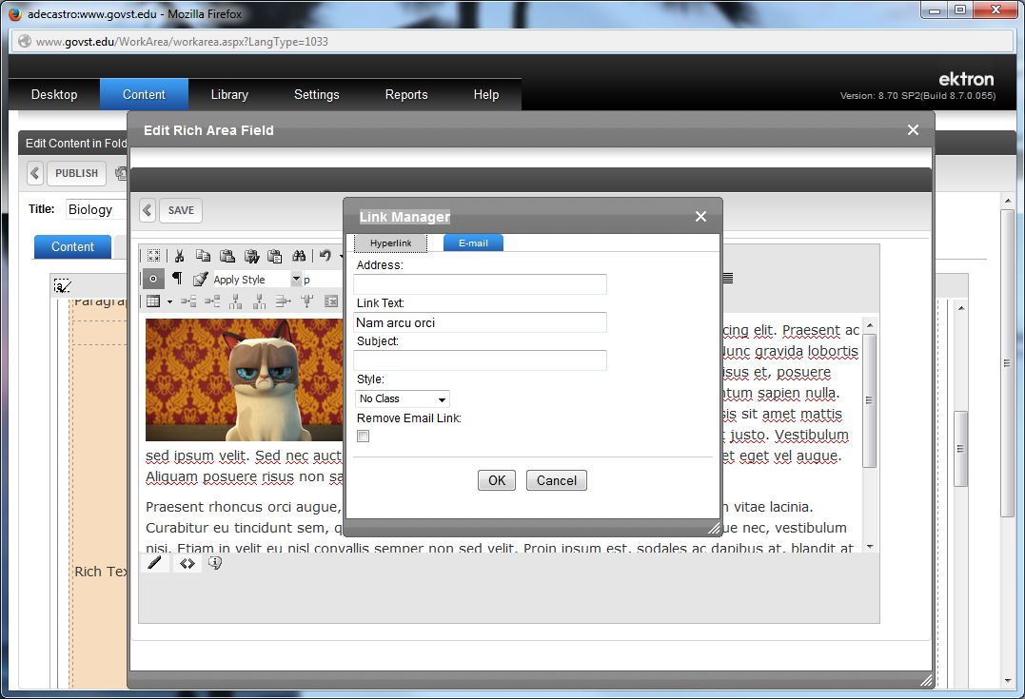
If you want to place an email link, select your text, click on the Link tool icon and in the Place link window click on the E-mail tab.
Then type in the e-mail address you want linked to.
You can even type in the Subject line for the e-mail.
Click on OK to save and place the link.

Slide 36
Click on Save to save the edit.

Slide 37
If you’re done editing your content click on the Save File icon to save it (It’s not live yet on the website). You can also preview your page by clicking on the Preview Page icon before you Publish after you save
If you want the updated content to go live on the website you can click on the Publish button.

Slide 38
You can also link and upload a PDF on the website while you edit your content. Click on the Edit page icon.

Slide 39
In the Edit Content window, select the text you want to use as a link.
After selecting text, click on the Link tool icon.

Slide 40
Click on this button to link to your PDF.

Slide 41
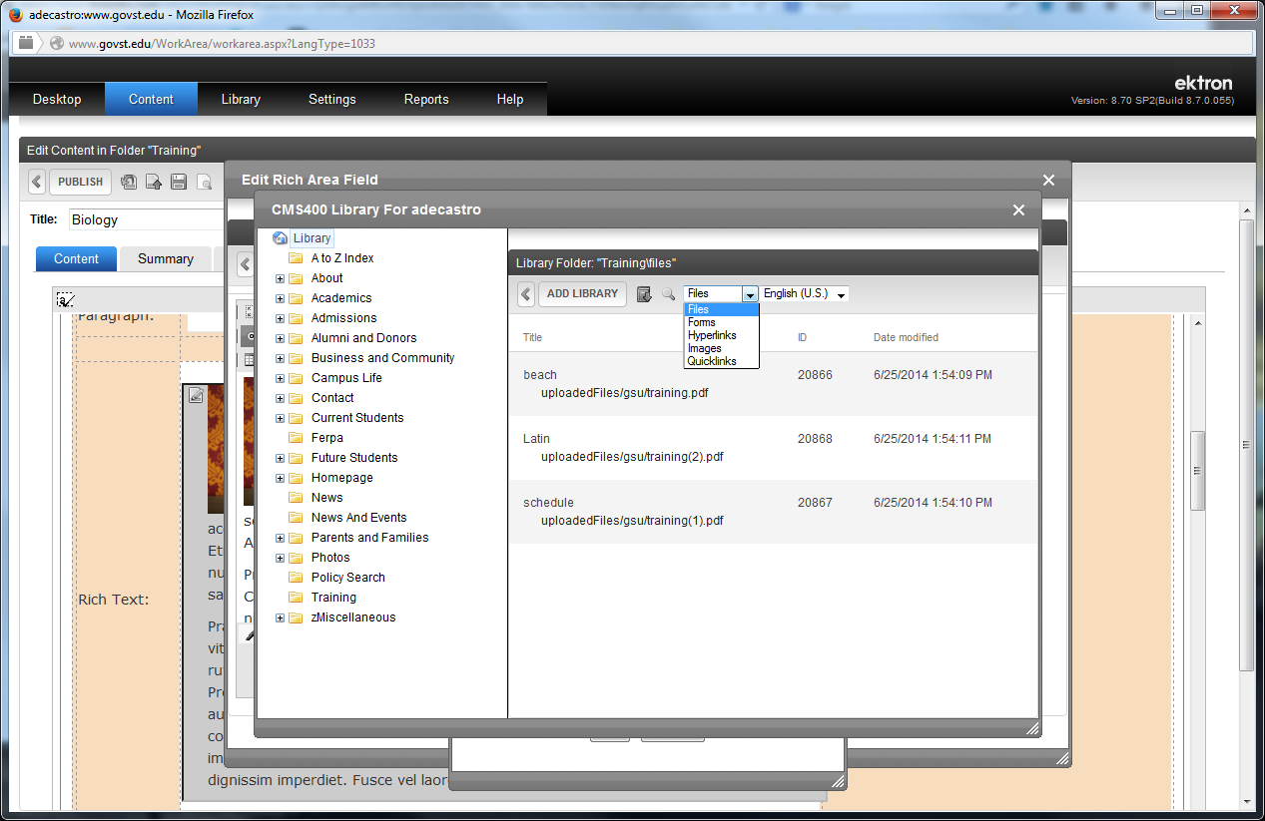
First Make sure you click on the dropdown menu and select Files for your PDF.

Slide 42
First Make sure you click on the dropdown menu and select Files for your PDF.

Slide 43
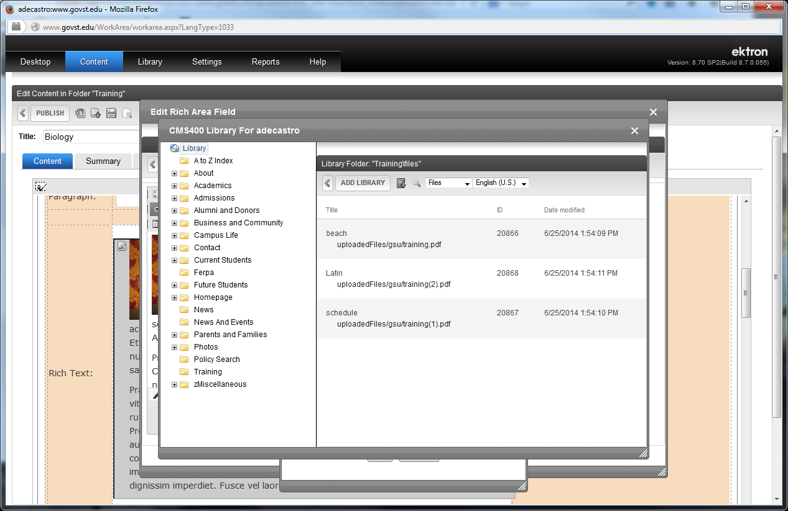
Click the ADD LIBRARY button to upload your PDF.

Slide 44
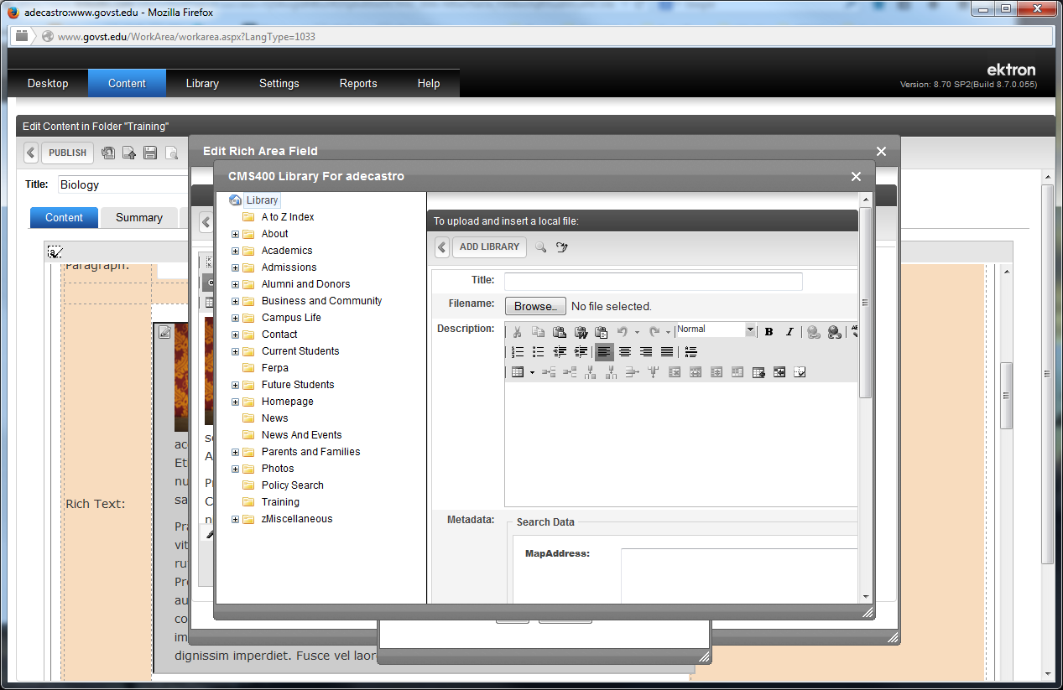
Type in a Title to give your PDF a file name in the CMS.
Click on BROWSE to select your PDF in your computer.

Slide 45
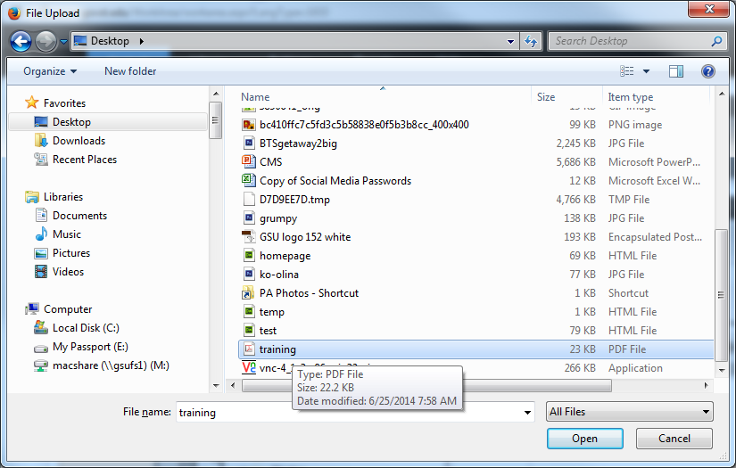
Select your PDF then click on OPEN.

Slide 46
Click the ADD LIBRARY button to save your PDF into the CMS.

Slide 47
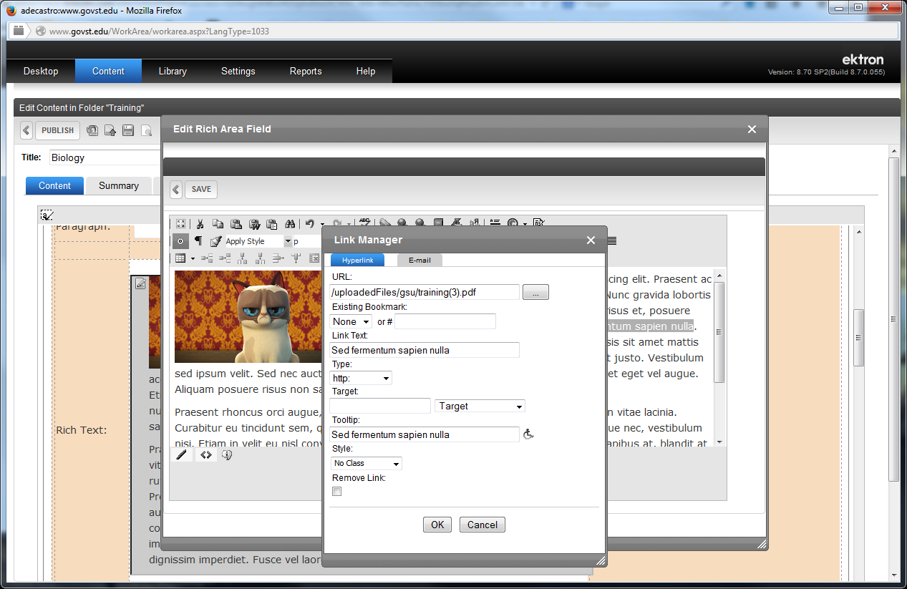
Click the OK button to link to your PDF from your web page.

Slide 48
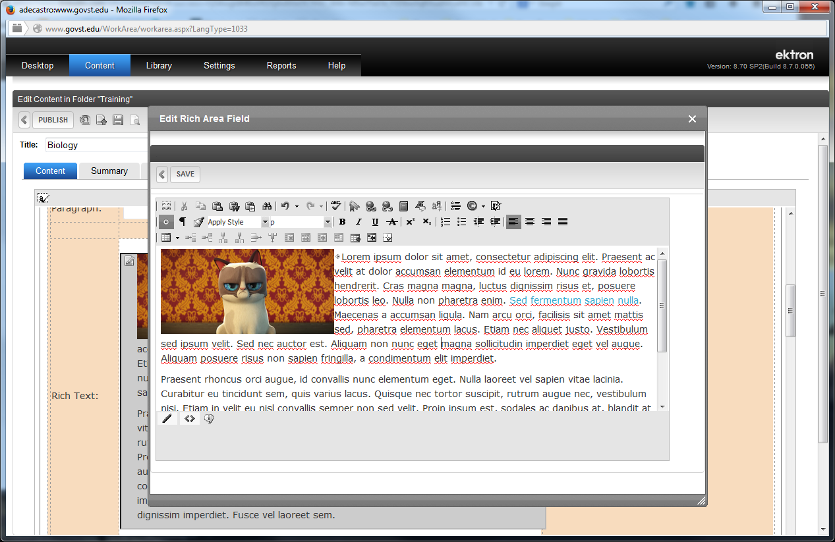
Click the SAVE button to save your updates.

Slide 49
If you’re done editing your content click on the Save File icon to save it (It’s not live yet on the website). You can also preview your page by clicking on the Preview Page icon before you Publish after you save
If you want the updated content to go live on the website you can click on the Publish button.

Slide 50
You can place a table into your web page if you need a grid will cells and rows to place your content into. Just click on the Edit Content icon.

Slide 51
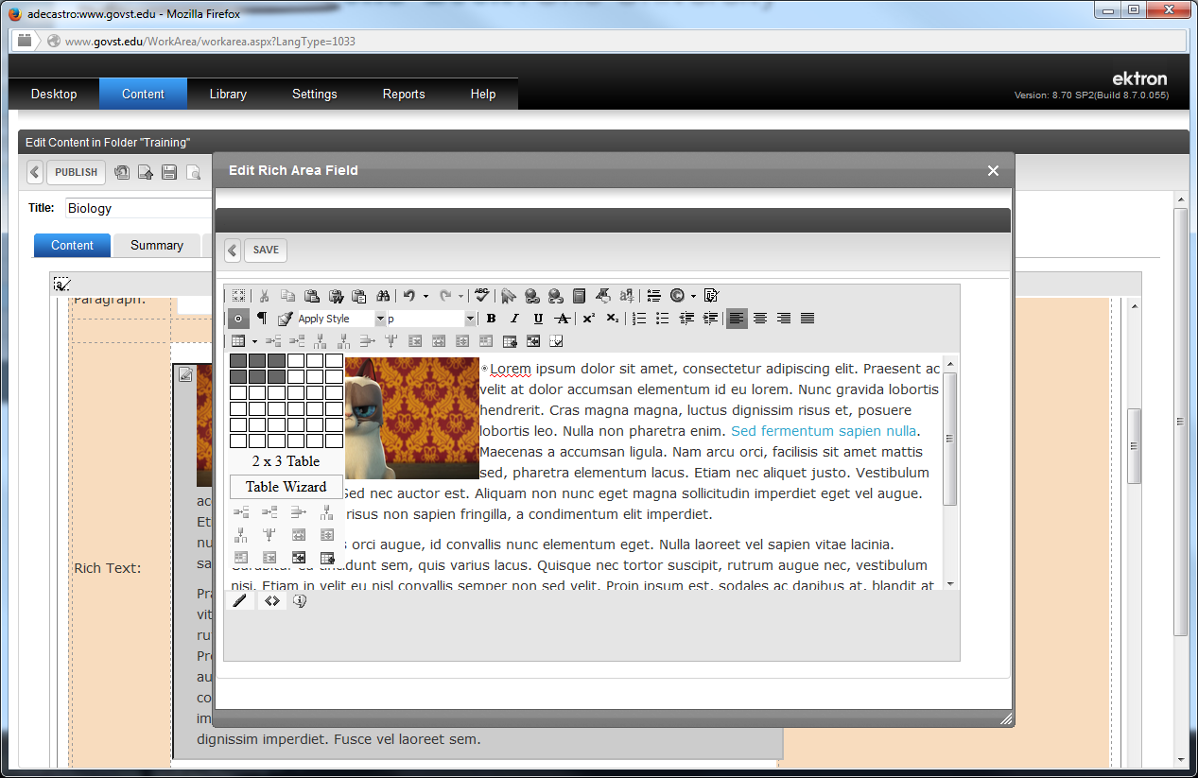
In the Edit Content window, click on the Table Grid icon and select the amount of rows and columns you need for the table in the grid.

Slide 52
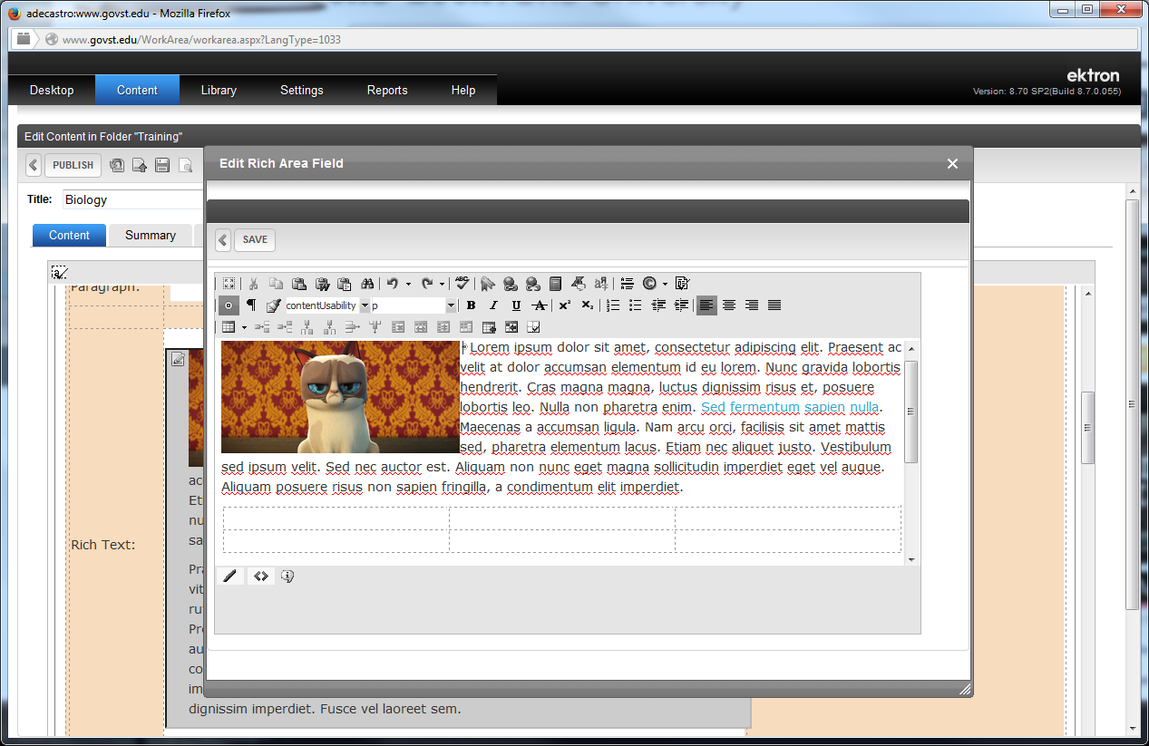
Your table appears in the area where you clicked on to place it.

Slide 53
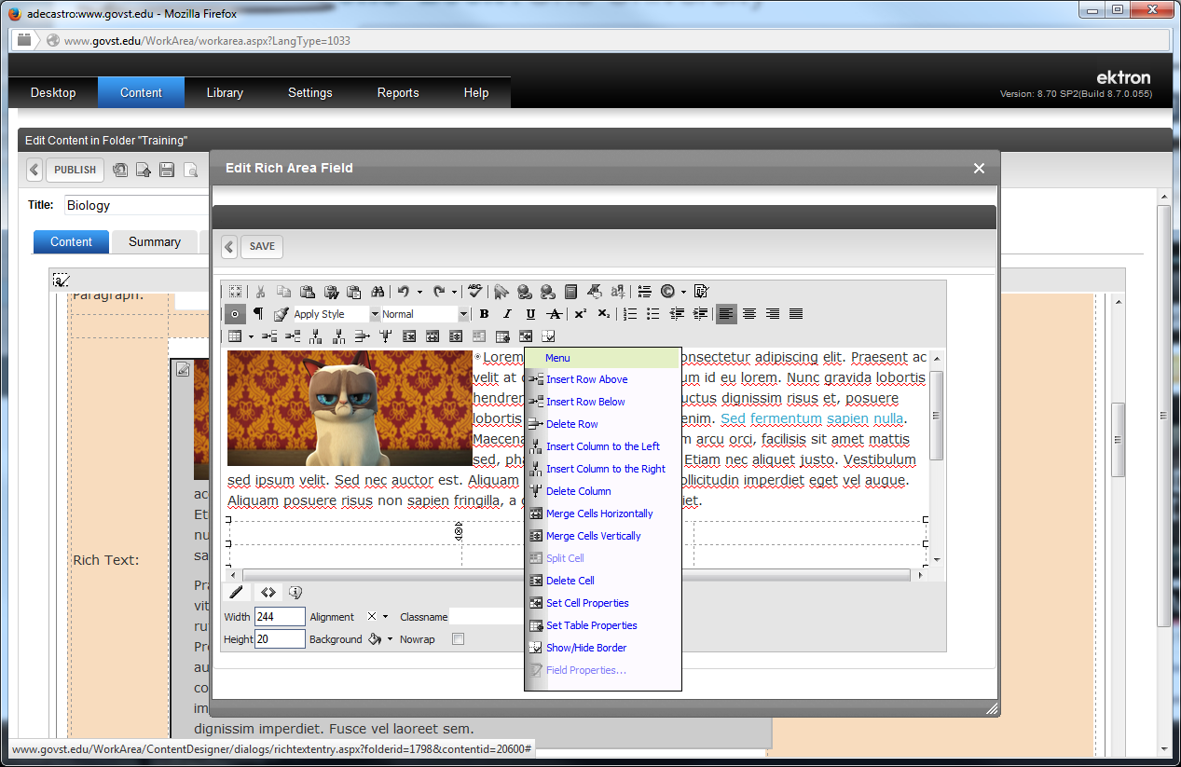
If you need to adjust your table, insert a row or column, delete a row or column, set the size of your table, the size of your cell, or modify the cell itself (like placing a background color), right-click inside the cell and a properties menu appears.
Select the property category you need to edit.

Slide 54
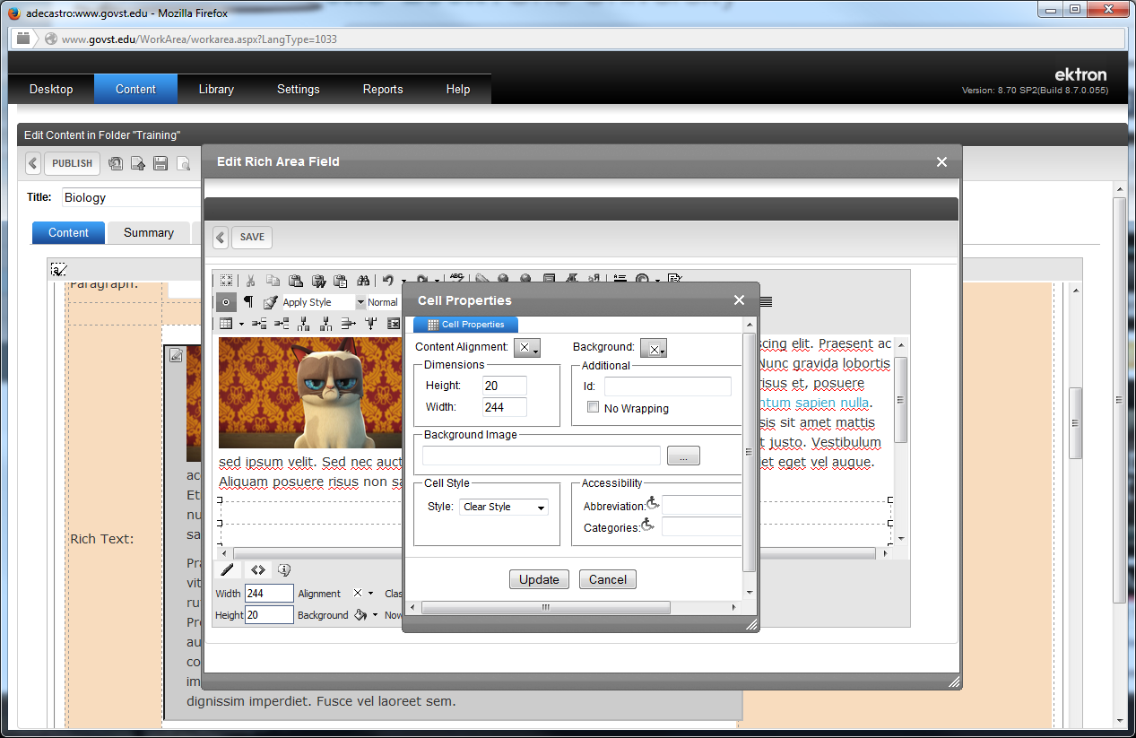
An edit properties window appears. Just make the changes you need and then click on the UPDATE button..

Slide 55
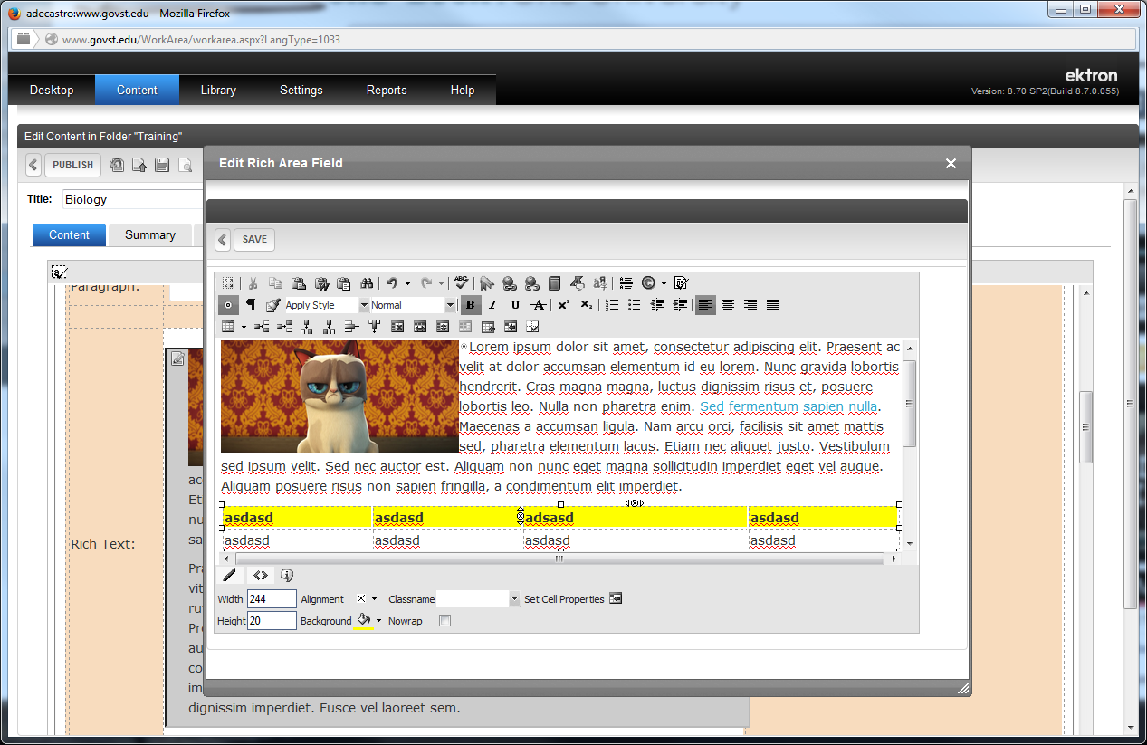
Your table should appear where you wanted it to appear.
Click on SAVE to change you updates.

Slide 56
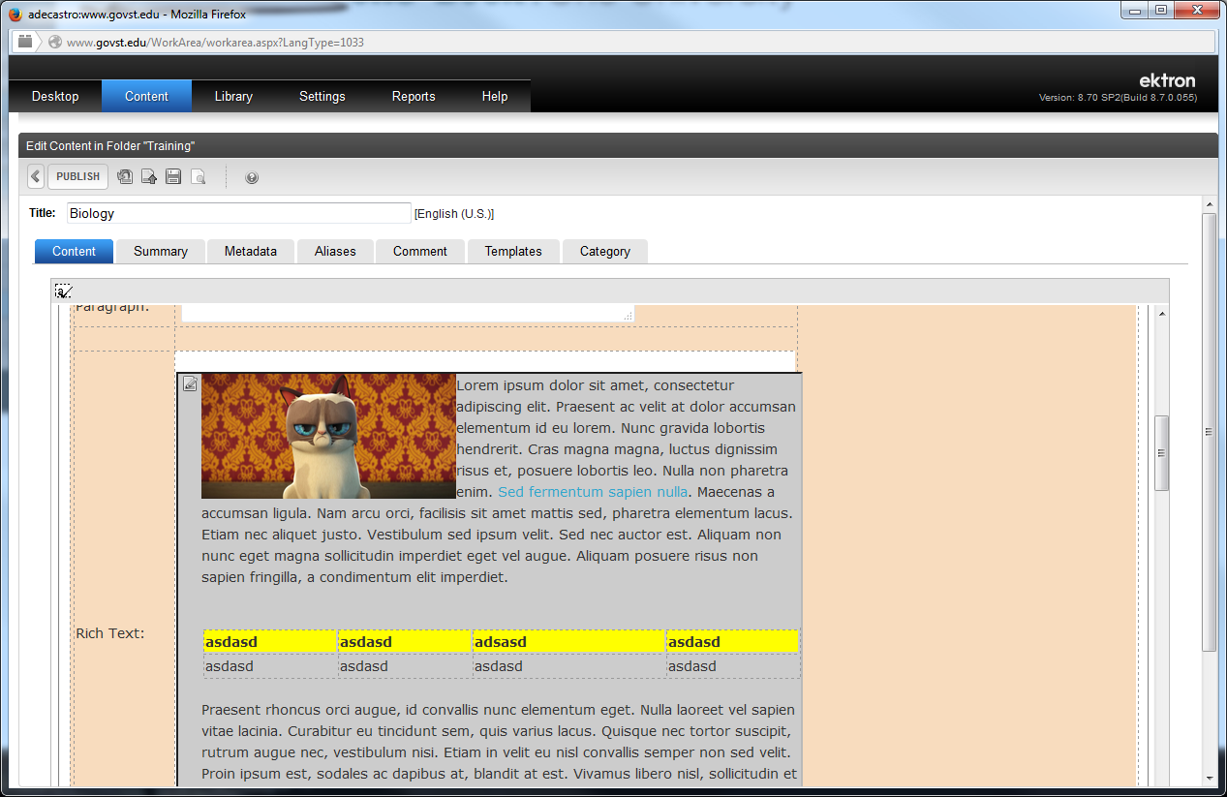
If you’re done editing your content click on the Save File icon to save it (It’s not live yet on the website). You can also preview your page by clicking on the Preview Page icon before you Publish after you save
If you want the updated content to go live on the website you can click on the Publish button.

Slide 57
How To Update an Existing PDF File
There will always be a need to update an existing PDF file from an outdated file
By using this method, all links that lead to this document will remain intact, meaning by updating this document users will not go to a broken link. It’s the same link just an updated document.

Slide 59
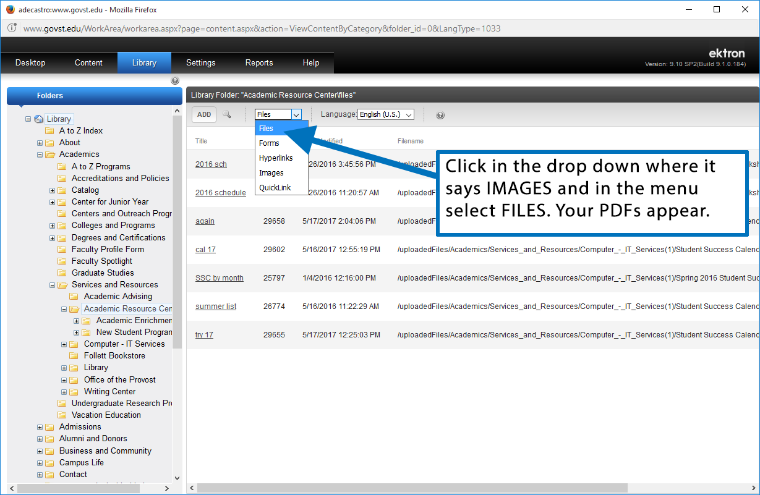

Slide 60
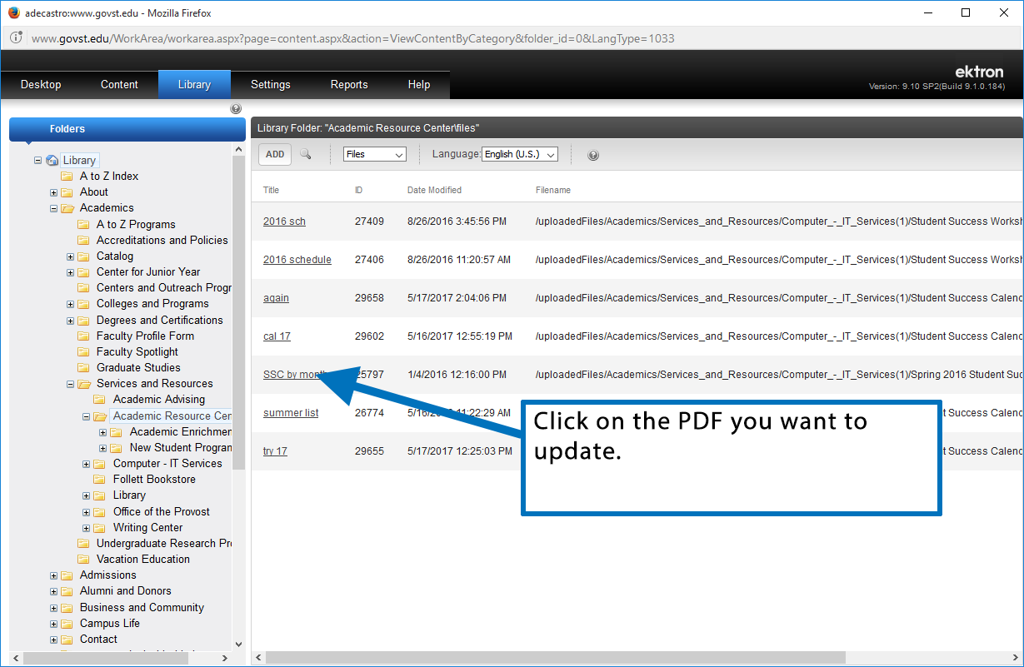

Slide 61
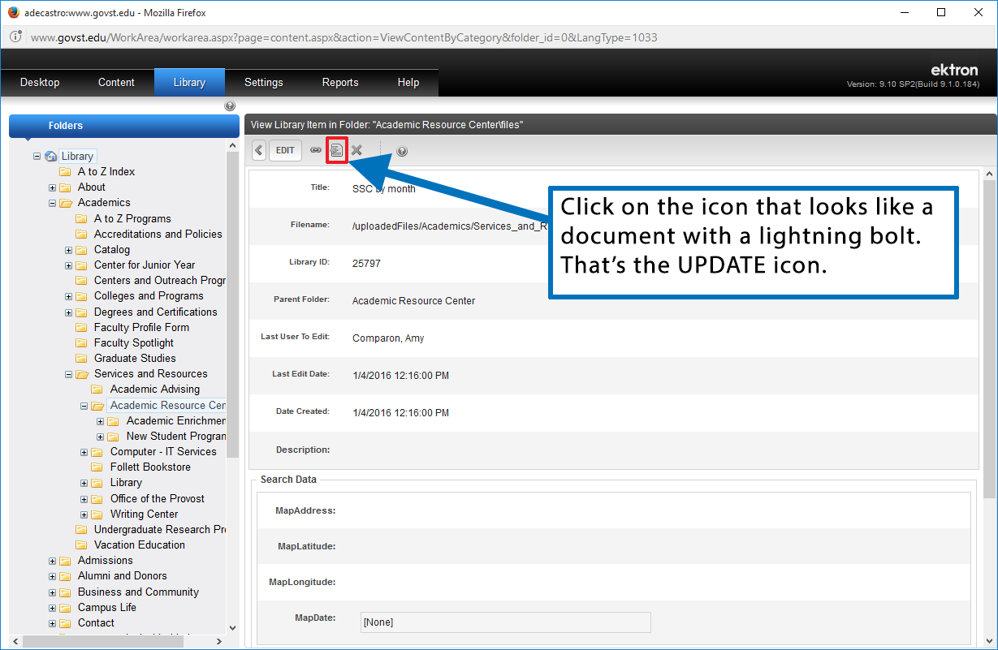

Slide 62
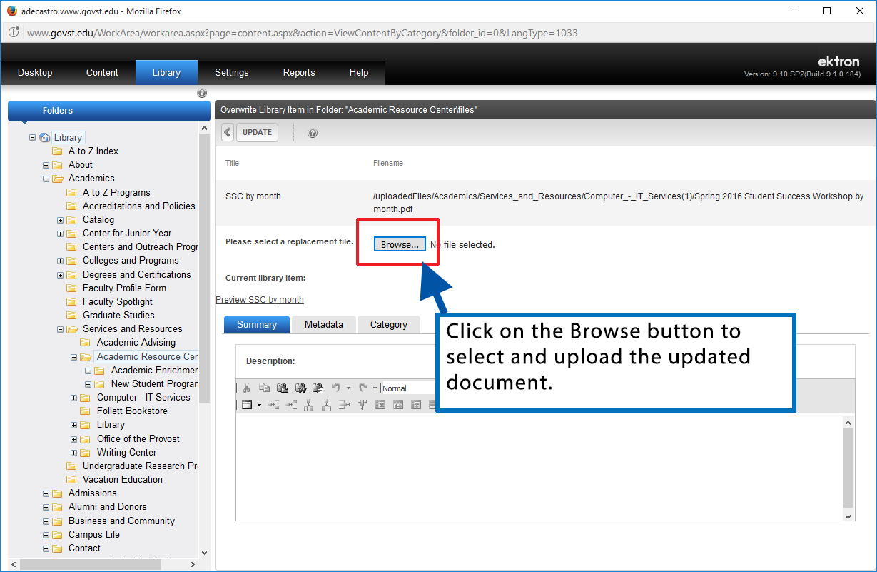

Slide 63
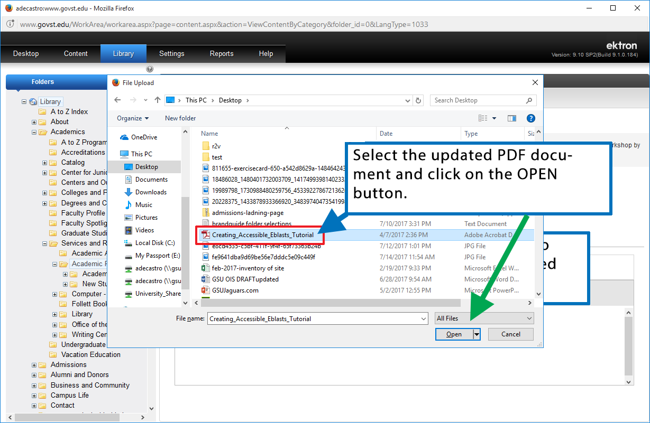

Slide 64
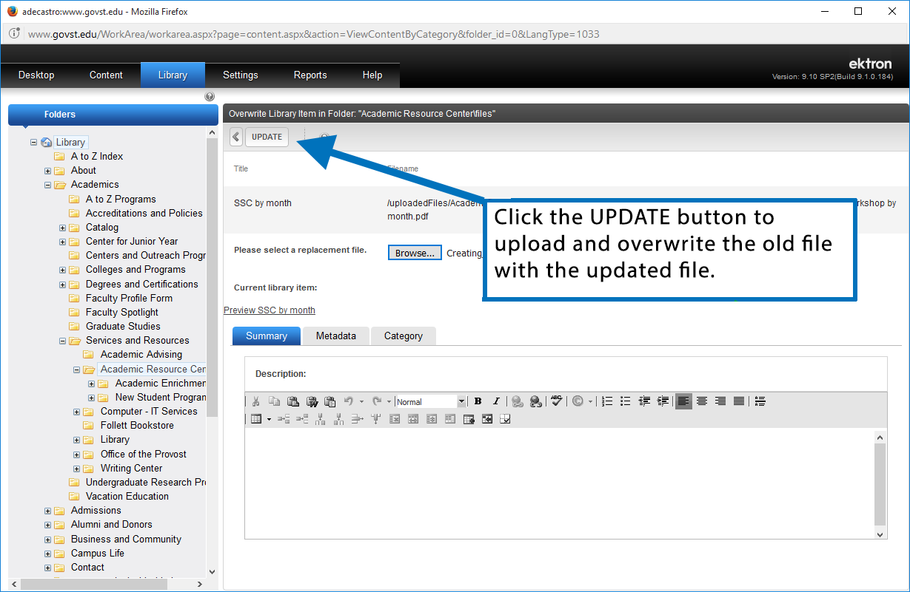

Slide 65
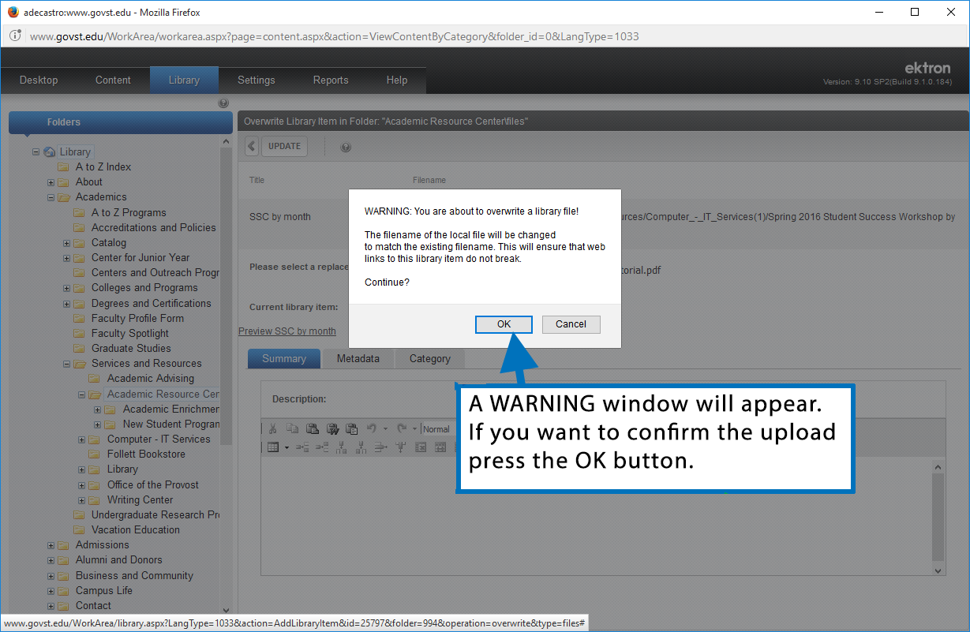

Slide 66
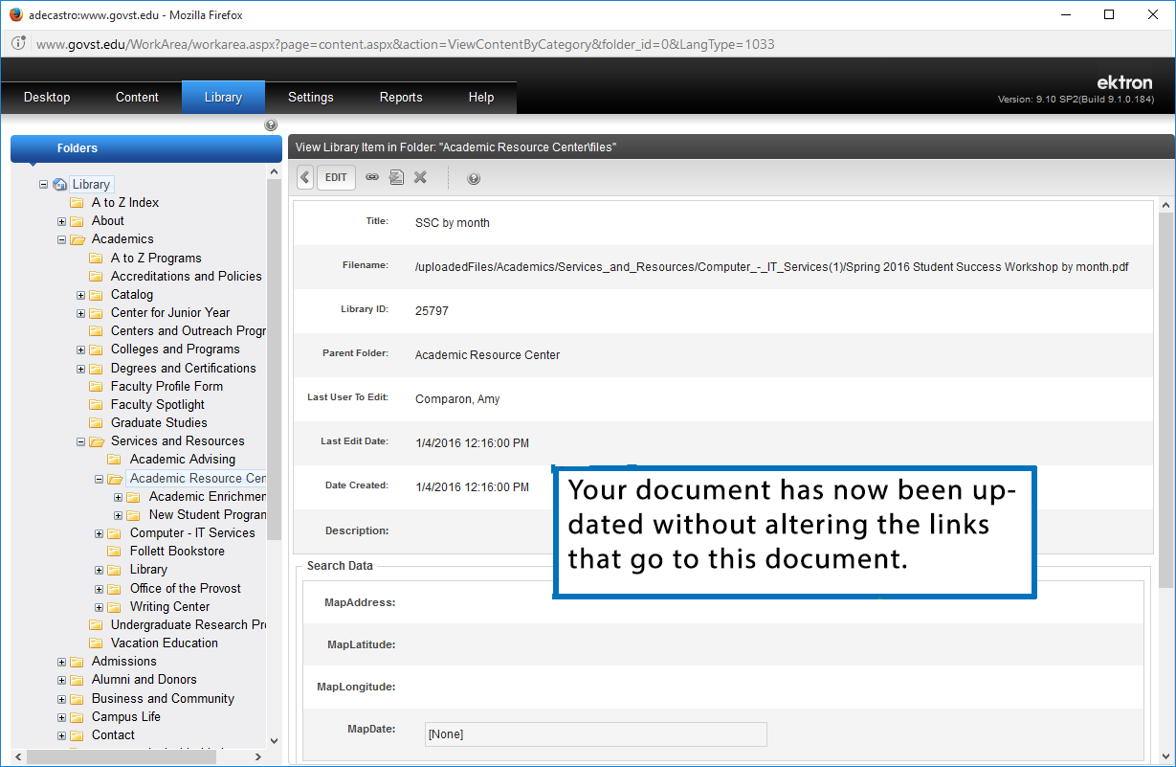

Slide 67
If you need assistance you can contact:
Antonio De Castro
Web Design Manager
adecastro@govst.edu
Or call (708) 534-8951

